Slide 1

Inventory Management Analysis
FP20 Analytics Challenge 25
By [Shweta Vishwakarma]

Slide 2

Project Overview
Power BI dashboard analyzing stock, suppliers, and inventory value. Built using DAX , interactive filters.

Slide 3
Dataset Summary
5000 product records with attributes like stock levels, lead time, reorder point, pricing, and country-level storage.

Slide 4
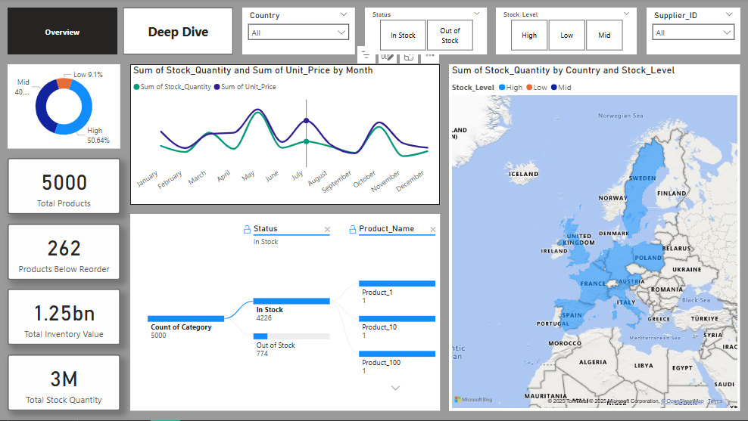

Slide 5

Page 1 – Overview Dashboard KPIs
Total Products: 5,000
Products Below Reorder: 262
Inventory Value: ₹1.25 Billion
Stock Quantity: 3 Million

Slide 6
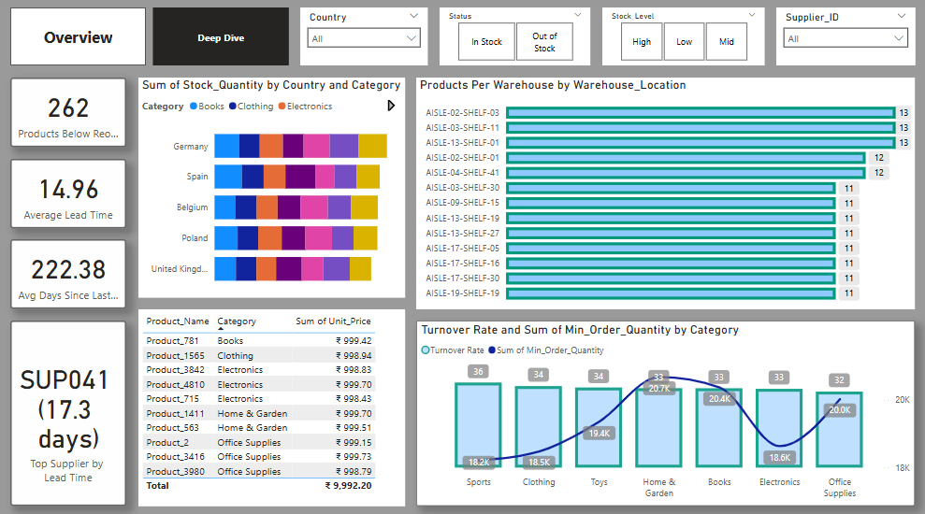

Slide 7
Page 2 – Deep Dive Insights
Avg Lead Time: 14.96 days
Avg Days Since Last Restock: 222.38 days
Top Supplier: SUP041 (17.3 days)

Slide 8

Business Questions Answered
Top Stocked Category: Clothing
Top Warehouse: AISLE-02/03-SHELF-11 (13 SKUs)
Top Country: Germany, Spain, Belgium

Slide 9
Business Recommendations
Restock 262 under-reorder products urgently
Negotiate lead times with SUP041
Reallocate stock between underutilized warehouses
Rotate slow-moving high-value items

Slide 10
Technical Highlights
2-page Power BI report
Custom DAX Measures & Tooltips
Slicers for category, supplier, country
Drill-through pages and visual bookmarks

Slide 11
Thank You!

